Slide 1


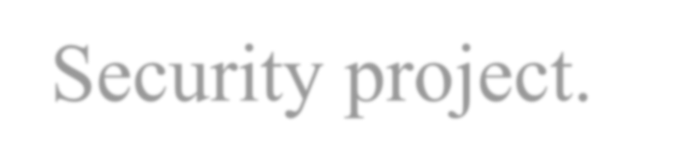
GLA UNIVERSITY , MATHURA
Application and Data Security project.
Name: Vivek Kashyap.
Section: 2SC.
Roll no.: 2415001808-(68)
Submitted to: Dr. Arvind Prasad

Slide 2
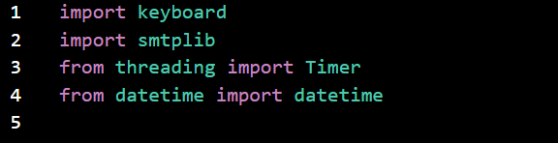
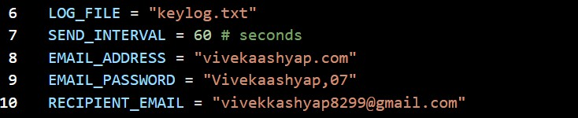
Keystroke Logging Demonstration – Project Explanation
INTRODUCTION
Hello everyone, my name is Vivek.
Today I am going to explain my Cyber Security project — a Keystroke Logging Demonstration.
This project is only for educational and research purposes to understand event handling, file handling, threading, and SMTP in Python.
PART 1 — IMPORT STATEMENTS
Explanation:
keyboard → captures key events on my own computer
smtplib → allows sending emails through SMTP
Timer → helps to schedule a task after a delay
datetime → for timestamps
This part explains how Python interacts with systems and schedules tasks.
PART 2 — CONFIGURATION VARIABLES
Explanation:

Slide 3
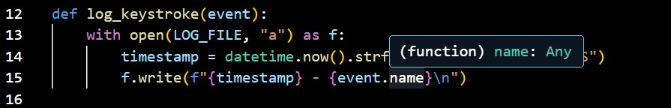

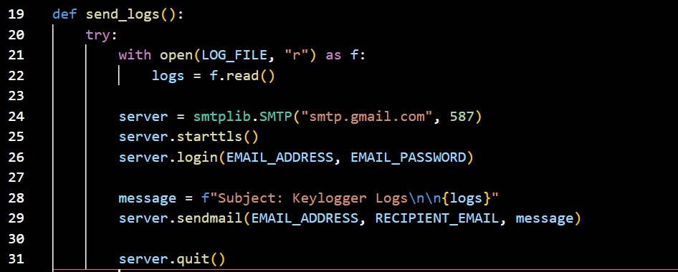
Stores all keystrokes in a log file
SEND_INTERVAL decides the delay for sending logs
Email credentials are used for SMTP authentication This part demonstrates setting configuration values.
PART 3 — LOGGING KEYSTROKES
Explanation:
This function runs whenever a key is pressed.
It logs the timestamp and the key pressed in the text file.
This demonstrates file handling, event handling, and timestamps.
PART 4 — EVENT REGISTRATION
Explanation:
This line tells Python to execute the log_keystroke function whenever a key is pressed. It demonstrates event-driven programming.
PART 5 — SENDING LOGS THROUGH EMAIL

Slide 4


Explanation:
This function reads the log file, connects to Gmail SMTP server, and sends the logs. It demonstrates Python email automation.
PART 6 — TIMER SETUP
Explanation:
This schedules the send_logs function to run after a set interval. It shows the use of multithreading and timed execution.
PART 7 — KEEPING THE PROGRAM RUNNING
Explanation:
This keeps the script active so it continues listening for keystrokes.
At Last
This project is strictly for learning event handling, file management, and email automation in Python.
It is meant to run only on my own system and not for any unethical purpose.
Thank you.

